Slide 1

Operational Efficiency in the Emergency Department
Using Predictive Analytics for Resource Optimization
Institution: DeVos Graduate School of Management, Northwood University

Slide 2
Executive Summary:y
Emergency Departments face challenges like overcrowding, long wait times, and high operational costs.
Predictive analytics (ARIMA and Gradient Boosting) can optimize staffing and inventory.
Goal: Enhance patient care and reduce operational inefficiencies.

Slide 3
Problem Statement:
Challenges in Emergency Departments:
Inefficient patient flow management.
Poor inventory control leading to stockouts or overstocking.
Long patient length of stay, increasing costs and decreasing satisfaction.

Slide 4
Research Objectives:
Predict patient admissions using time-series forecasting.
Optimize staffing schedules to match patient demand.
Improve inventory management with predictive models.
Develop actionable insights for better resource allocation.

Slide 5
Methodoloy Overview
Data Collection:
Dataset sourced from Kaggle (healthcare admissions, staffing, inventory). Models Used:
ARIMA: Short-term patient admission forecasting.
Gradient Boosting: Long-term prediction with external factors (e.g., holidays). Tools: Python (Pandas, Matplotlib).

Slide 6
Key Findings
ARIMA Model:
Effective for short-term trends and seasonality.
Challenges in capturing sudden spikes.
Gradient Boosting:
Handles complex variables (time, holidays, weather).
Higher accuracy but computationally intensive.

Slide 7
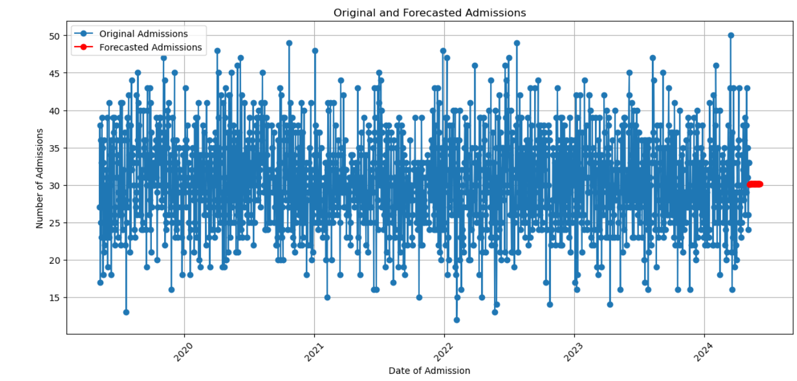
ARIMA MODEL: Graph Overview: The plot displays Original Admissions (blue dots) and Forecasted Admissions (red line) over time. The x-axis represents the Date of Admission spanning multiple years (from 2020 to 2024). The y-axis represents the Number of Admissions ranging between 15 and 50.

Slide 8
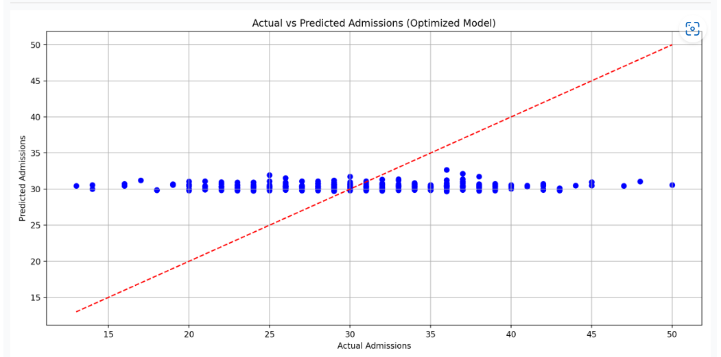
GRADIENT BOOSTING: This is a machine learning technique adopted for regression and classification. It builds a ensemble of the weak prediction model-usually in a tree form in a greedy manner, where each tries to fix errors of its forerunners. The word "gradient" actually means to use the gradient descent-algorithm to optimize loss functions, hence predicting values closest to reality.

Slide 9
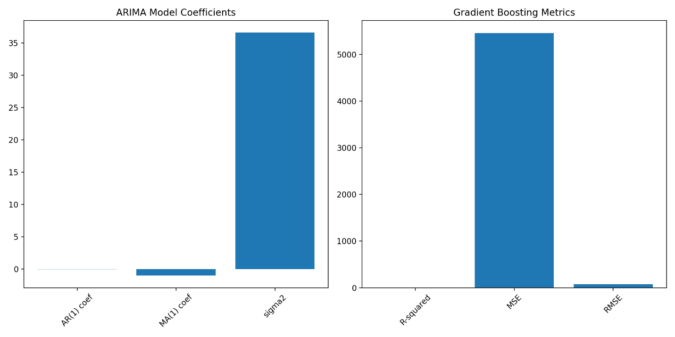
Model Comparison:
Model Performance Summary:
ARIMA: Handles linear and seasonality components but shows high variance, limiting its performance.
Gradient Boosting: Better at handling non-linear patterns but produces higher errors (MSE) potentially due to overfitting or insufficient parameter tuning.

Slide 10
Recommendations
Implement Predictive Models:
Use ARIMA for short-term staffing.
Use Gradient Boosting for long-term planning.
Optimize Inventory Management:
Align stock levels with patient demand forecasts.
Train Staff:
Conduct workshops to enhance understanding of predictive tools.

Slide 11
Expected Outcomes:
Reduced patient wait times and improved satisfaction.
Cost-effective resource allocation.
Real-time operational insights for better decision-making.

Slide 12

Conclusion:
Predictive analytics can revolutionize ED operations.
Combining ARIMA and Gradient Boosting offers a
comprehensive solution for staffing and inventory challenges.
Future work: Refine models for better real-time application.

